Slide 1
Time series
ESTP Training
05-07 October 2026

Slide 2
1. Outline
“Regular” time series
Basic tools
  Auto-correlation function
  Periodogram
  Linear filter
Stationarity
Arima model

Slide 3
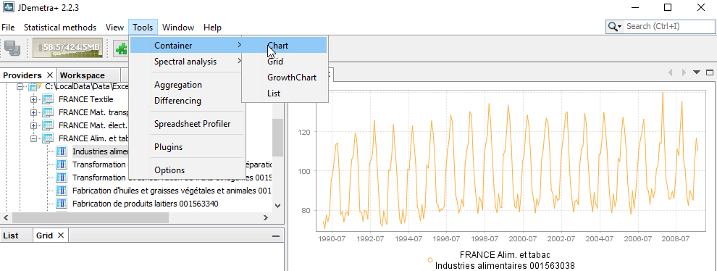
2. Time series
We will only consider « regular » time series
  Monthly, quarterly…[, yearly] time series
  Annual frequency: 12, 6, 4, 3, 2, 1
[ JD+ 3.0 deal with more general time series]

Slide 4
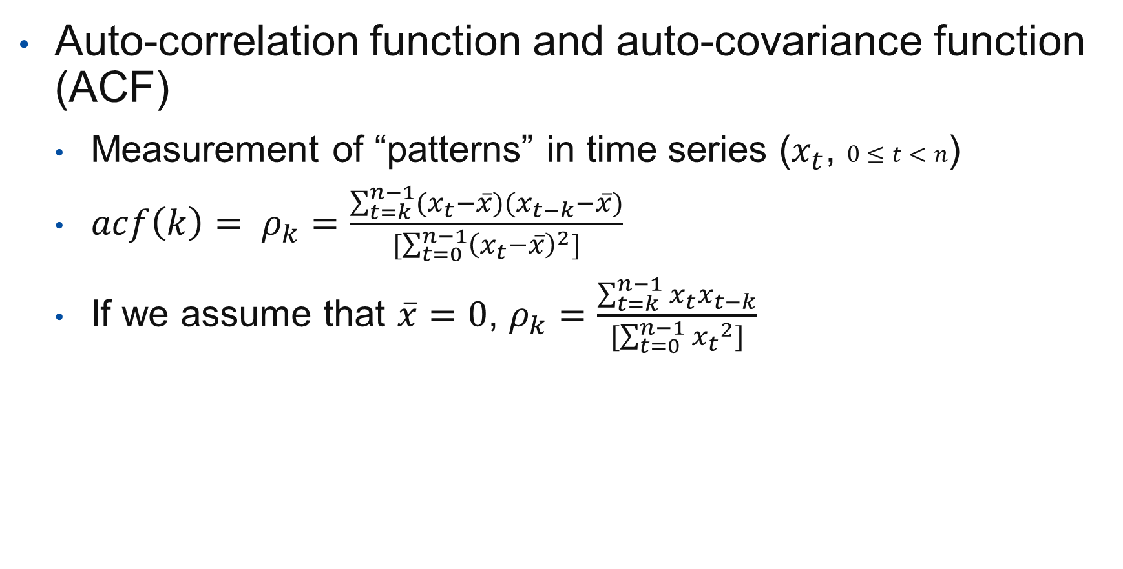
3. Basic tools
Auto-correlation function and auto-covariance function (ACF)
  Measurement of “patterns” in time series ($x_{t}$, $0≤t<n$)
  $acf\left(k\right)= ρ_{k}=\frac{\sum_{t=k}^{n−1}{(x_{t}−\overline{x})(x_{t−k}−\overline{x})}}{[\sum_{t=0}^{n−1}{{\left(x_{t}−\overline{x}\right)}^{2}}]}$
  If we assume that $\overline{x}=0$, $ρ_{k}=\frac{\sum_{t=k}^{n−1}{x_{t}x_{t−k}}}{[\sum_{t=0}^{n−1}{{x_{t}}^{2}}]}$

Slide 5
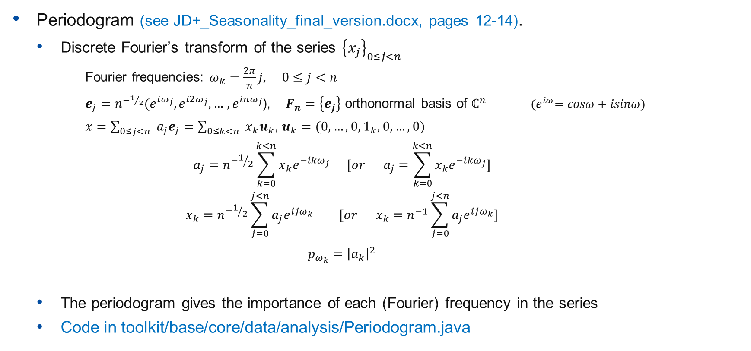
3. Basic tools (cont.)
Periodogram (see JD+_Seasonality_final_version.docx, pages 12-14).
  Discrete Fourier’s transform of the series ${\left\{x_{j}\right\}}_{0≤j<n }$
    Fourier frequencies: $ω_{k}=\frac{2π}{n}j, 0≤j<n$
    $e_{j}=$ $n^{−1/2}(e^{iω_{j}},e^{i2ω_{j}},…$ $,e^{inω_{j}}$), $F_{n}=\left\{e_{j}\right\}$ orthonormal basis of $ℂ^{n}$ ${(e}^{iω}=cosω+isinω)$
    $x=\sum_{0≤j<n }{a_{j}e_{j}}=\sum_{0≤k<n }{x_{k}u_{k}}$, $u_{k}=(0,…, 0, 1_{k}, 0, …,0)$
    $$a_{j}=n^{−1/2}\sum_{k=0}^{k<n}{x_{k}e^{−i{kω}_{j}}} [or a_{j}=\sum_{k=0}^{k<n}{x_{k}e^{−i{kω}_{j}}}]$$
    $$x_{k}=n^{−1/2}\sum_{j=0}^{j<n}{a_{j}e^{ijω_{k}}} [or x_{k}=n^{−1}\sum_{j=0}^{j<n}{a_{j}e^{ijω_{k}}}]$$
    $$p_{ω_{k}}={\left|a_{k}\right|}^{2}$$
  The periodogram gives the importance of each (Fourier) frequency in the series
  Code in toolkit/base/core/data/analysis/Periodogram.java

Slide 6
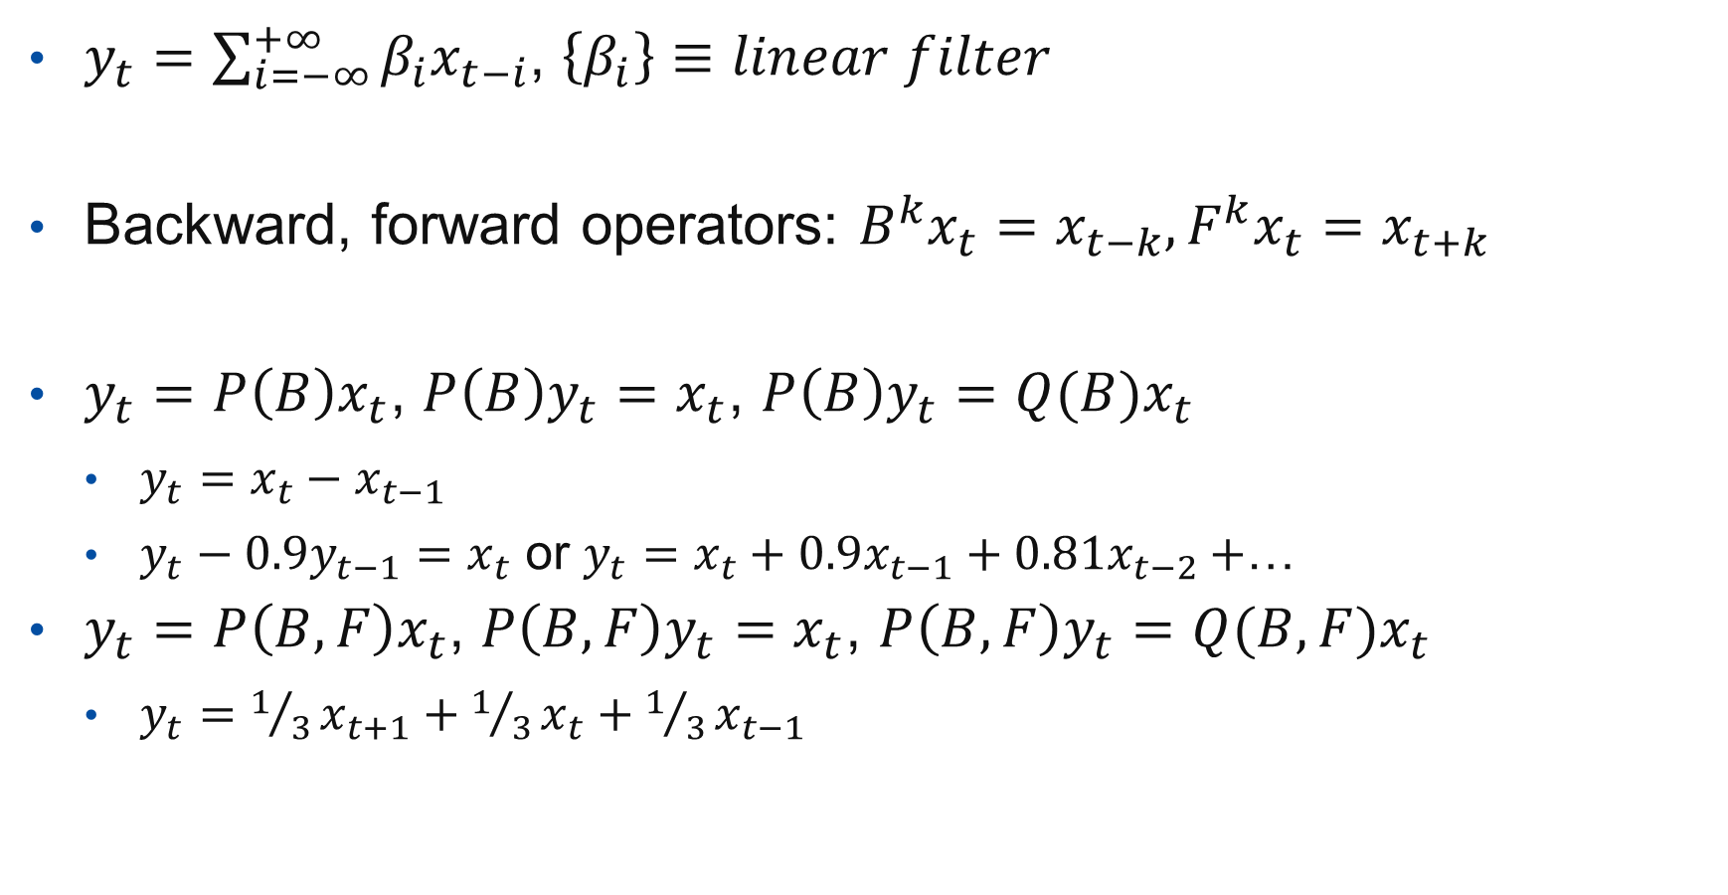
3. Linear filters
$y_{t}=\sum_{i=−∞}^{+∞}{β_{i}x_{t−i}}$, $\left\{β_{i}\right\}≡linear filter$
Backward, forward operators: $B^{k}x_{t}=x_{t−k},F^{k}x_{t}=x_{t+k}$
$y_{t}=P\left(B\right)x_{t}$, $P\left(B\right)y_{t}=x_{t}$, $P\left(B\right)y_{t}={Q(B)x}_{t}$
  $y_{t}=x_{t}−x_{t−1}$
  $y_{t}−0.9y_{t−1}=x_{t}$ or $y_{t}=x_{t}+0.9x_{t−1}+0.81x_{t−2}+$…
$y_{t}=P\left(B, F\right)x_{t}$, $P\left(B, F\right)y_{t}=x_{t}$, $P\left(B, F\right)y_{t}={Q(B, F)x}_{t}$
  $y_{t}={1/3x}_{t+1}+1/3x_{t}+1/3x_{t−1}$

Slide 7

3. Linear filters: properties
Filter:
$$y_{t}=\sum_{j=−∞}^{+∞}{β_{j}x_{t−j}}$$
Frequency response:
$$F(ω)=\sum_{j=−∞}^{+∞}{β_{j}e^{−iωj}}$$
Gain, phase
  |$F_{t}\left(ω\right)|, arg⁡(F_{t}\left(ω\right)$

Slide 8
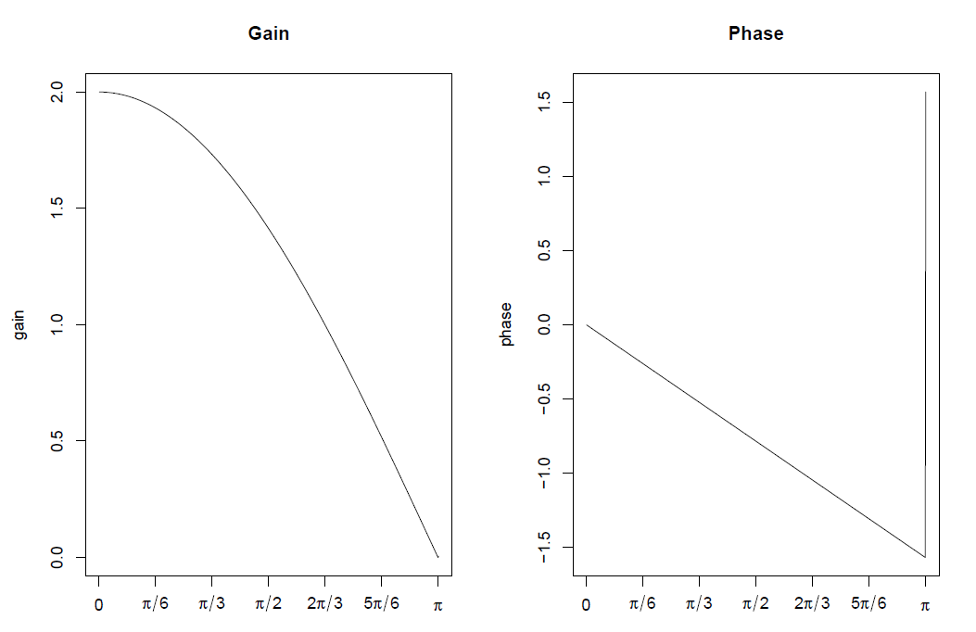
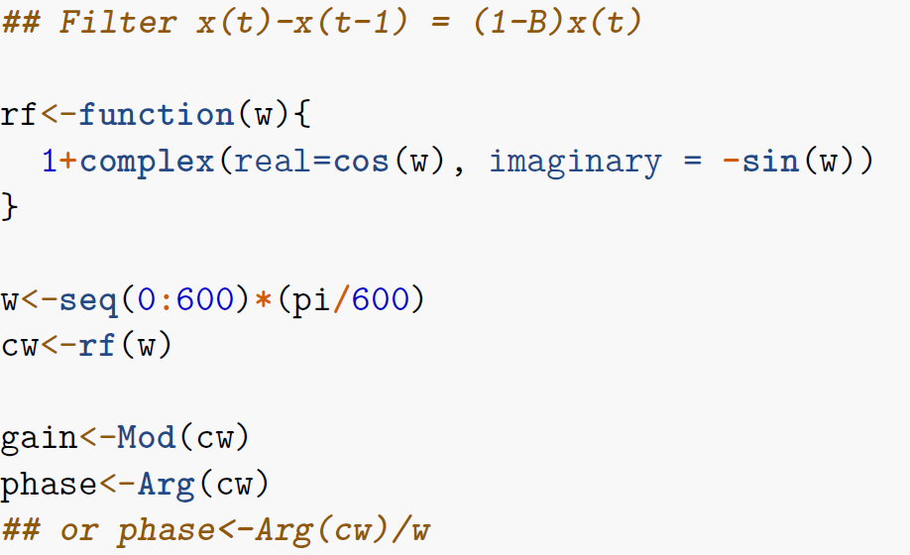
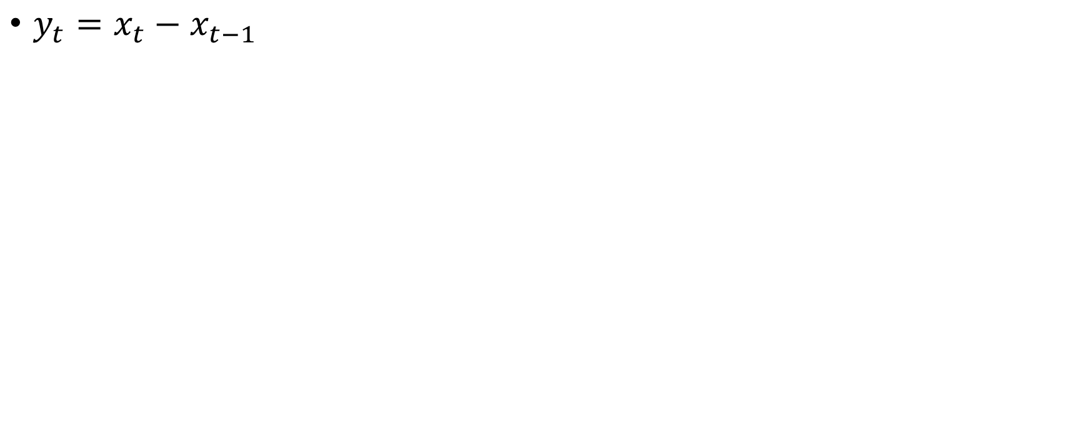
3. Linear filters: properties
$y_{t}=x_{t}−x_{t−1}$

Slide 9
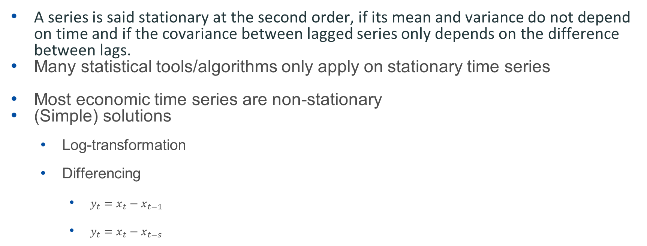
4. Stationarity
A series is said stationary at the second order, if its mean and variance do not depend on time and if the covariance between lagged series only depends on the difference between lags.
Many statistical tools/algorithms only apply on stationary time series
Most economic time series are non-stationary
(Simple) solutions
  Log-transformation
  Differencing
    $y_{t}=x_{t}−x_{t−1}$
    $y_{t}=x_{t}−x_{t−s}$

Slide 10
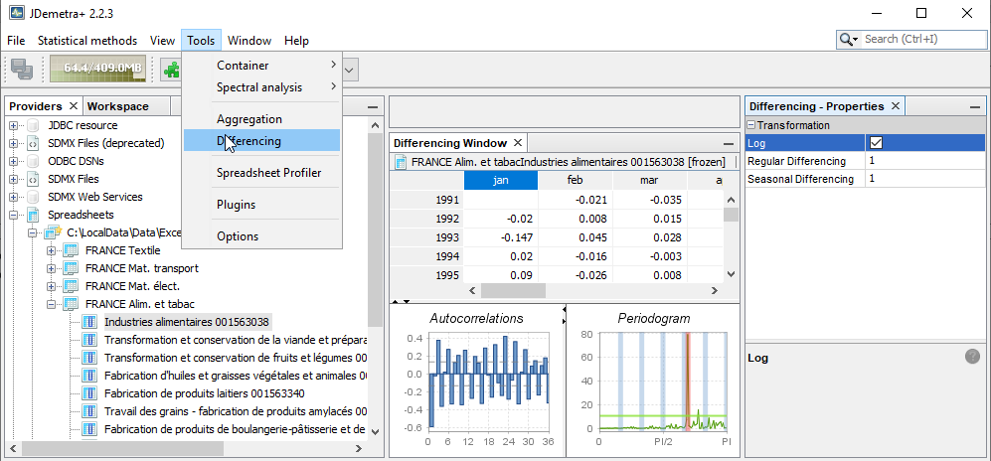
Stationary series

Slide 11
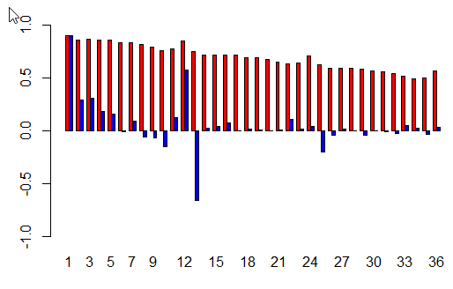
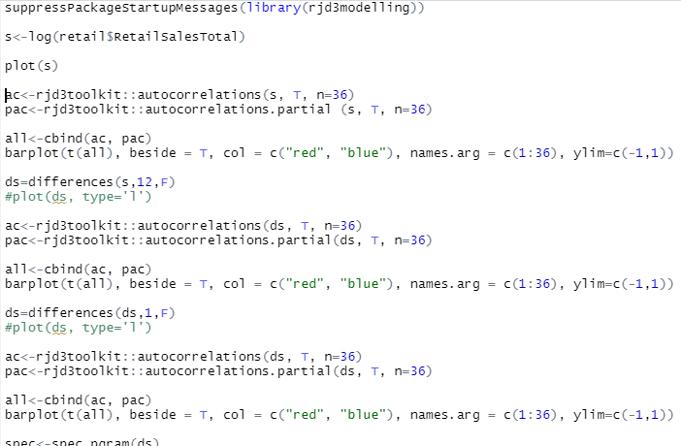
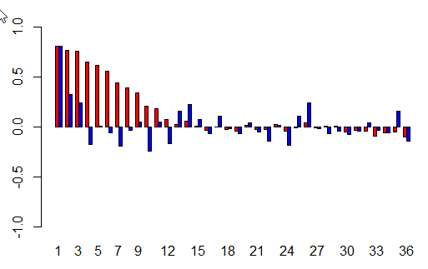
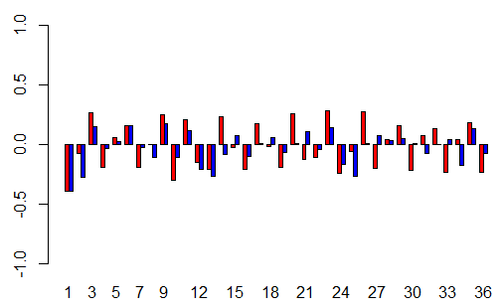
Stationary series in R

Slide 12
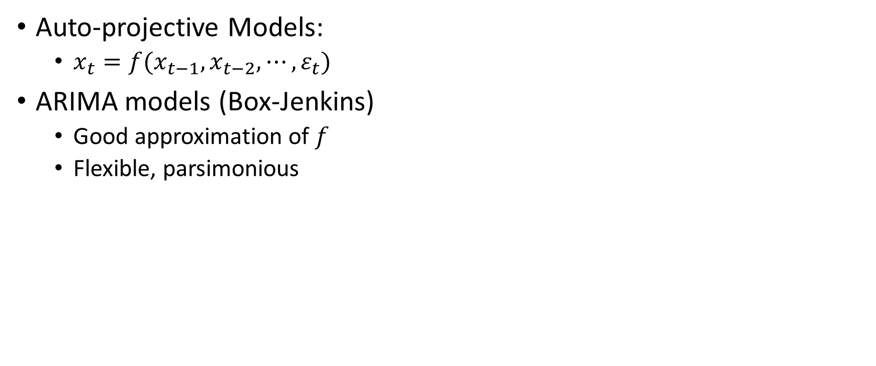
Arima models
Auto-projective Models:
  $x_{t}=f(x_{t−1},x_{t−2},⋯,ε_{t})$
ARIMA models (Box-Jenkins)
  Good approximation of $f$
  Flexible, parsimonious

Slide 13
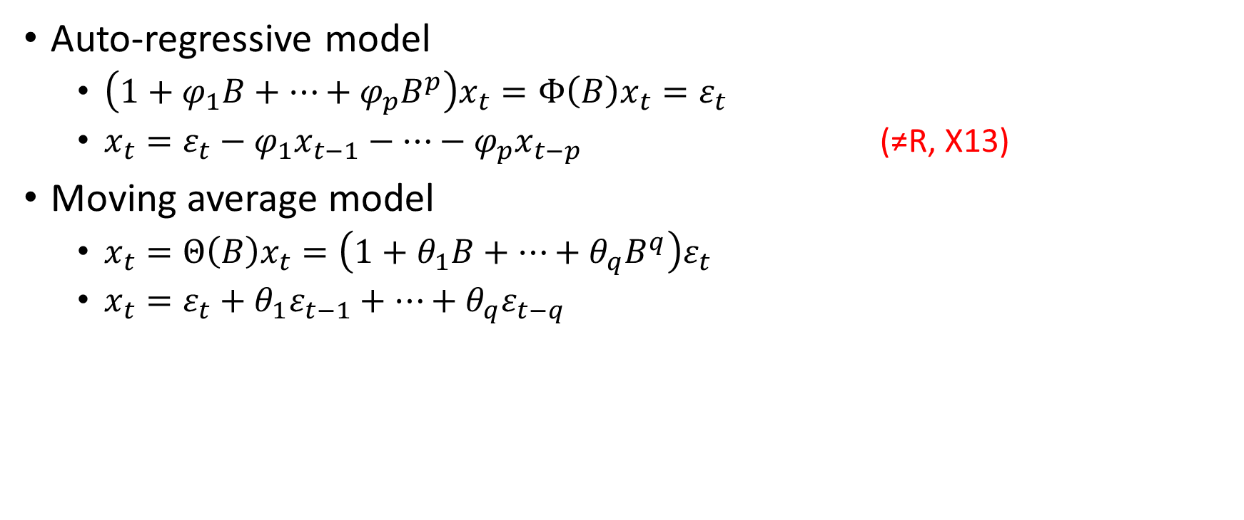
Arima models (definitions)
Auto-regressive model
  $\left(1+φ_{1}B+⋯+φ_{p}B^{p}\right)x_{t}=Φ\left(B\right)x_{t}=ε_{t}$
  $x_{t}=ε_{t}−φ_{1}x_{t−1}−⋯−φ_{p}x_{t−p}$ (≠R, X13)
Moving average model
  $x_{t}=Θ\left(B\right)x_{t}={\left(1+θ_{1}B+⋯+θ_{q}B^{q}\right)ε}_{t}$
  $x_{t}=ε_{t}+θ_{1}ε_{t−1}+⋯+θ_{q}ε_{t−q}$

Slide 14
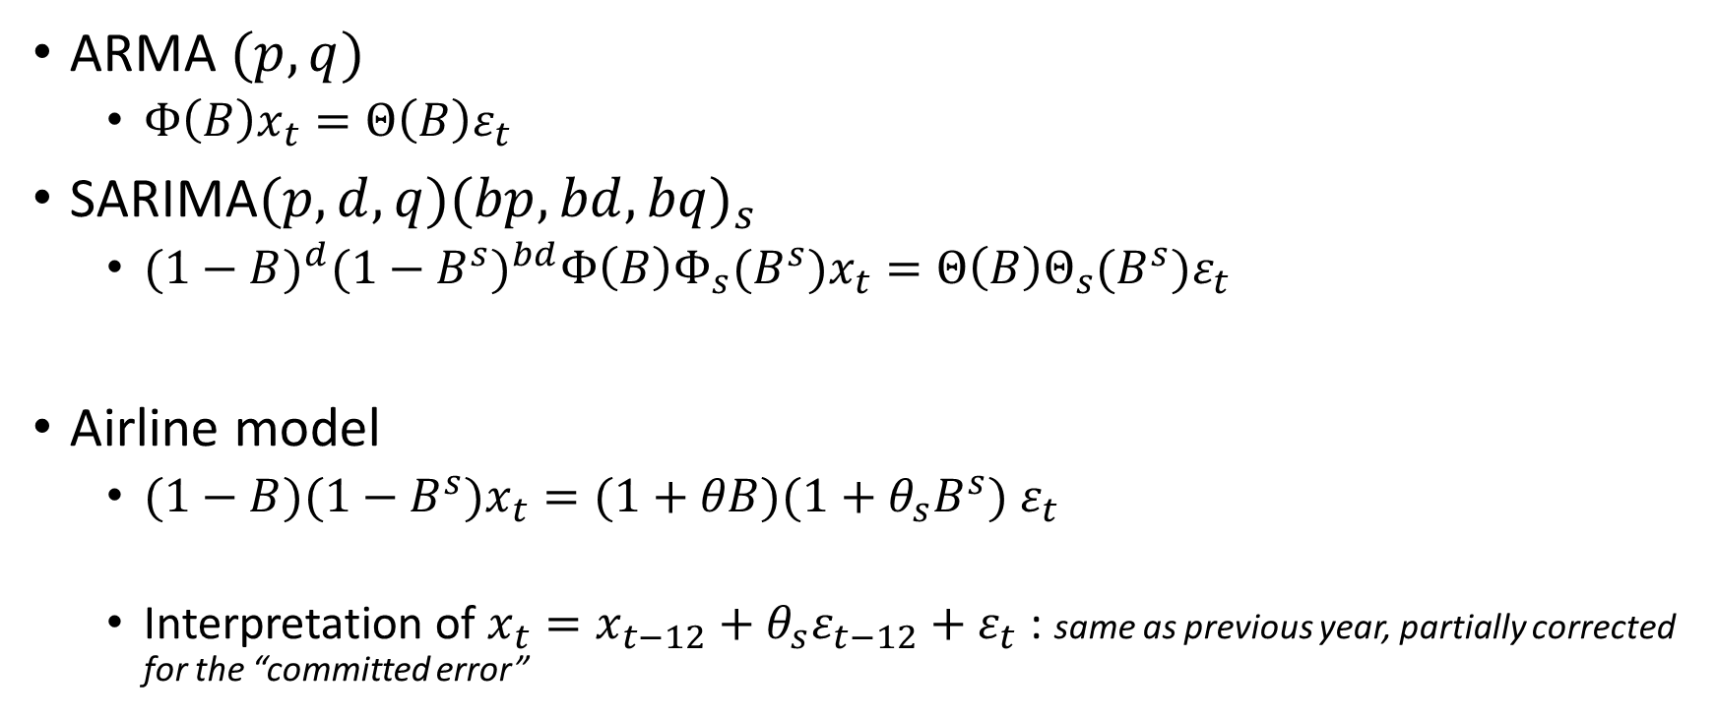
Arima models (definitions)
ARMA $(p, q)$
  $Φ\left(B\right)x_{t}=Θ\left(B\right)ε_{t}$
SARIMA$(p,d,q){(bp, bd, bq)}_{s}$
  ${(1−B)}^{d}{(1−B^{s})}^{bd}Φ\left(B\right)Φ_{s}(B^{s})x_{t}=Θ\left(B\right)Θ_{s}(B^{s})ε_{t}$
Airline model
  $(1−B)(1−B^{s})x_{t}=(1+θB)(1+θ_{s}B^{s}) ε_{t}$
  Interpretation of $x_{t}=x_{t−12}+θ_{s}ε_{t−12}+ε_{t}$ : same as previous year, partially corrected for the “committed error”

Slide 15
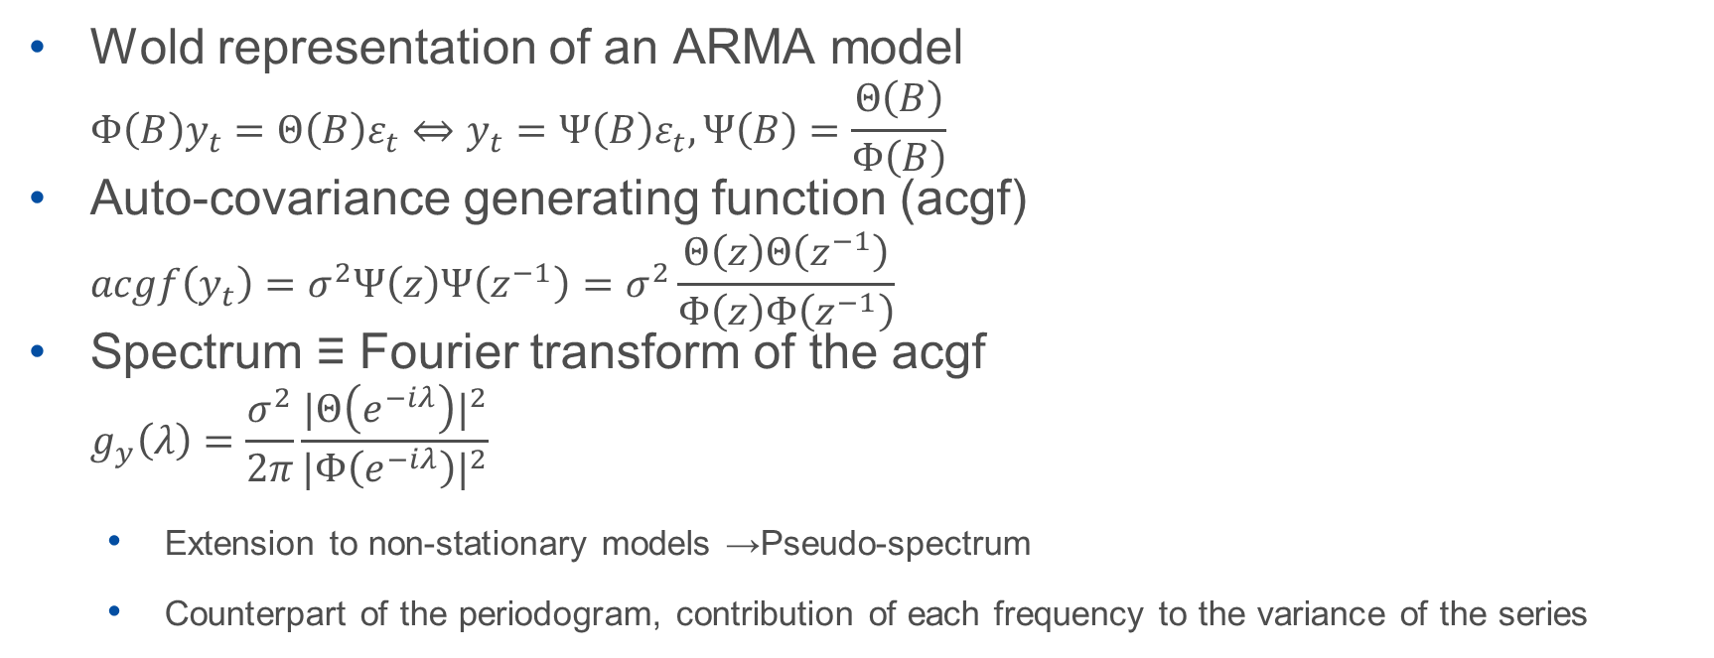
Arima model properties
Wold representation of an ARMA model
  $$Φ\left(B\right)y_{t}=Θ\left(B\right)ε_{t}⇔y_{t}=Ψ\left(B\right)ε_{t},Ψ\left(B\right)=\frac{Θ\left(B\right)}{Φ\left(B\right)}$$
Auto-covariance generating function (acgf)
  $$acgf\left(y_{t}\right)=σ^{2}Ψ\left(z\right)Ψ\left(z^{−1}\right)=σ^{2}\frac{Θ\left(z\right)Θ\left(z^{−1}\right)}{Φ\left(z\right)Φ\left(z^{−1}\right)}$$
Spectrum ≡ Fourier transform of the acgf
  $$g_{y}\left(λ\right)=\frac{σ^{2}}{2π}\frac{{|Θ\left(e^{−iλ}\right)|}^{2}}{{|Φ\left(e^{−iλ}\right)|}^{2}}$$
  Extension to non-stationary models →Pseudo-spectrum
  Counterpart of the periodogram, contribution of each frequency to the variance of the series

Slide 16
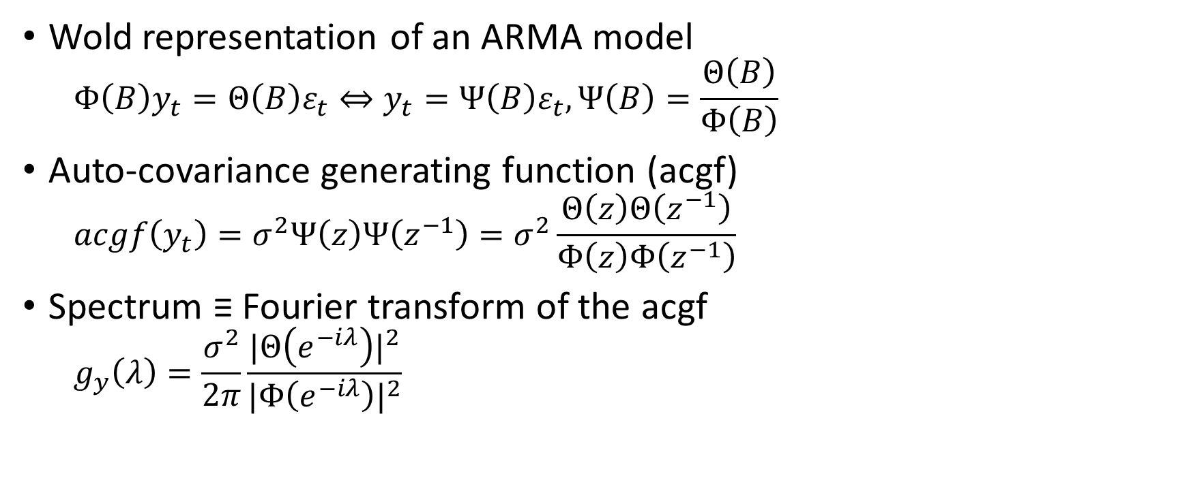
Wold representation of an ARMA model
  $$Φ\left(B\right)y_{t}=Θ\left(B\right)ε_{t}⇔y_{t}=Ψ\left(B\right)ε_{t},Ψ\left(B\right)=\frac{Θ\left(B\right)}{Φ\left(B\right)}$$
Auto-covariance generating function (acgf)
  $$acgf\left(y_{t}\right)=σ^{2}Ψ\left(z\right)Ψ\left(z^{−1}\right)=σ^{2}\frac{Θ\left(z\right)Θ\left(z^{−1}\right)}{Φ\left(z\right)Φ\left(z^{−1}\right)}$$
Spectrum ≡ Fourier transform of the acgf
  $$g_{y}\left(λ\right)=\frac{σ^{2}}{2π}\frac{{|Θ\left(e^{−iλ}\right)|}^{2}}{{|Φ\left(e^{−iλ}\right)|}^{2}}$$

Slide 17
Final remarks
Importance of the representation in the frequency domain for series decomposition
  Trend ≈ low frequencies
  Seasonal ≈ seasonal frequencies (related to the periodicity)
  Irregular ≈ high-frequencies
Especially true for SEATS

